Slide 1
Introduction to Big Data

Slide 2
What’s Big Data?
No single definition; here is from Wikipedia:
Big data is the term for a collection of data sets so large and complex that it becomes difficult to process using on-hand database management tools or traditional data processing applications.
Data Challenges include capture, curation, storage, search, share, transfer, analyze, and visualization.

Slide 3
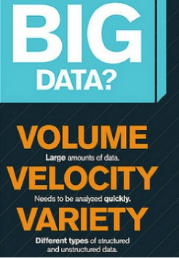
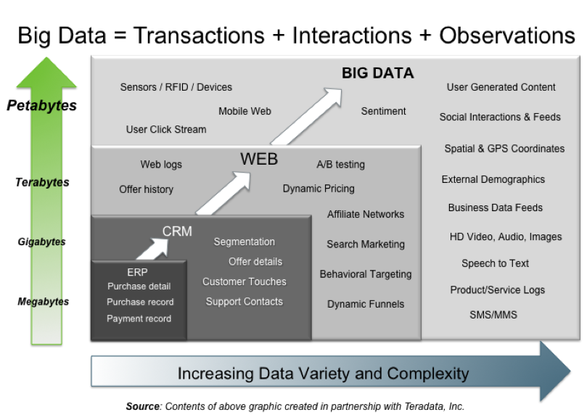
Big Data: 3V’s
Courtesy Dr. Jin

Slide 4
Variety (Complexity)
Relational Data: Tables/Transaction/Legacy Data
Text Data: Web, smart devices, speech, logs, etc.
unstructured Data: XML, audio, images, etc.
Graph Data
Social Network, Semantic Web (RDF), …
Streaming Data
You can only scan the data once
Public Data (online, weather, finance, policy, regulatory, legacy, etc.)
Big Data → (Data Science) → Knowledge

Slide 5
Velocity (Speed)
Data is generated fast and needs to be processed fast
Online Data Analytics
Late decisions ➔ missing opportunities
Examples
E-Promotions: Based on your current location, your purchase history, predict your likes/dislikes ➔ send promotions right now for store next to you
Peer-pressure campaigns (recommend products from what others with similar interests brought?)
Precision Health: Sensors monitoring your activities and body ➔ report results to care provider for immediate action

Slide 6
Cloud Computing
Cloud Computing is an on-demand delivery of IT resources in a PAYG model.
IT resources provided as a service
Compute, storage, databases, visualization
Leverages economies of scale of commodity hardware
Cheap storage, high bandwidth networks & multicore processors
Geographically distributed data centers
Popular providers
Microsoft Azure, Amazon AWS, Google Cloud Project

Slide 7
Cloud Computing Architecture
“Cloud Computing by Indon is licensed under the CC BY-SA 3.0 Unported. All other content herein is licensed and copyright under different terms and by different parties.”
Wikipedia: Cloud Computing

Slide 8
Benefits of Cloud Computing
Cost & management
Economies of scale, “out-sourced” resource management
Reduced Time to deployment
Ease of assembly, works “out of the box”
Scaling
On demand provisioning, co-locate data and compute
Reliability
Massive, redundant, shared resources
Sustainability
Hardware not owned

Slide 9
Types of Cloud Computing
Public Cloud: Computing infrastructure is hosted at the vendor’s premises.
Private Cloud: Dedicated to the customer and is not shared with other organizations.
Hybrid Cloud: A combination of both private and public clouds. Example: Private cloud hosts critical, proprietary, business sensitive, and secure applications in private clouds. Public cloud for general purpose usage.
Cloud bursting: Use local/own infrastructure for normal usage, but cloud is used for peak workloads.

Slide 10
Cloud Service Oriented Architecture
Infrastructure as a service (IaaS)
Offering hardware related services using the principles of cloud computing. These could include storage services (database or disk storage) or virtual servers.
Amazon EC2, Amazon S3, Rackspace Cloud Servers and Flexiscale.
Platform as a Service (PaaS)
Offering a development platform on the cloud.
Google’s Application Engine, Microsofts Azure, Salesforce.com’s force.com .
Software as a service (SaaS)
Including a complete software offering in the cloud. Users can access a software application hosted by the cloud vendor on PAYG
Salesforce.com offering in the online Customer Relationship Management (CRM) space, gmail, hotmail, Google docs.

Slide 11
Key Ingredients in Cloud Computing
Service-Oriented Architecture (SOA)
Utility Computing (on demand)
Virtualization (P2P Network)
SaaS (Software as a Service)
PaaS (Platform as a Service)
IaaS (Infrastructure aS a Service)
Web Services in the Cloud

Slide 12
Enabling Technology: Virtualization
App
App
App
App
App
App
OS
OS
OS
Operating System
Hypervisor
Hardware
Hardware
Traditional Stack
Virtualized Stack

Slide 13
Everything as a Service
Utility computing = Infrastructure as a Service (IaaS)
Why buy machines when you can rent cycles?
Examples: Amazon’s EC2, Rackspace
Platform as a Service (PaaS)
Give me nice API and take care of the maintenance, upgrades, …
Example: Google App Engine
Software as a Service (SaaS)
Just run it for me!
Example: Gmail, Salesforce

Slide 14
References:
No Official Textbooks
Hadoop: The Definitive Guide by Tom White, O’Reilly
Hadoop In Action by Chuck Lam, Manning
Data-Intensive Text Processing with MapReduce by Jimmy Lin and Chris Dyer (www.umiacs.umd.edu/~jimmylin/MapReduce-book-final.pdf)
Data Mining: Concepts and Techniques, Third Edition by Jiawei Han et al.
Many Online Tutorials, Reports, and Papers

